Slide 1
Azure Community Conference 2021

Slide 2
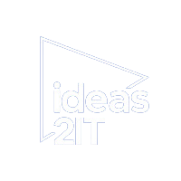


Gold Partner
Venue Partner
Learning Partner

Slide 3

Ashwini Mahendiran
Associate Developer

Slide 4
Empowering Insights: Developing a Multi-Document RAG Application in Azure

Slide 5
RAG – Retrieval Augmented Generation
External
Information
LLM
Generation
Retrieval Augmentation
Notes:
The Multi-Document Retrieval-Augmented Generation (RAG) model is an extension of the Retrieval-Augmented Generation (RAG) model that enhances its capability to handle multiple documents for generating contextually rich responses. The RAG model itself combines the strengths of retrieval-based and generation-based approaches to natural language understanding and generation.

Slide 6
Model
RAG Model
Retrieval Component
Generation
Component

Slide 7
Azure Services
Azure
AI Services
Open AI
Vision
Functions
Web Apps
Storage Services

Slide 8
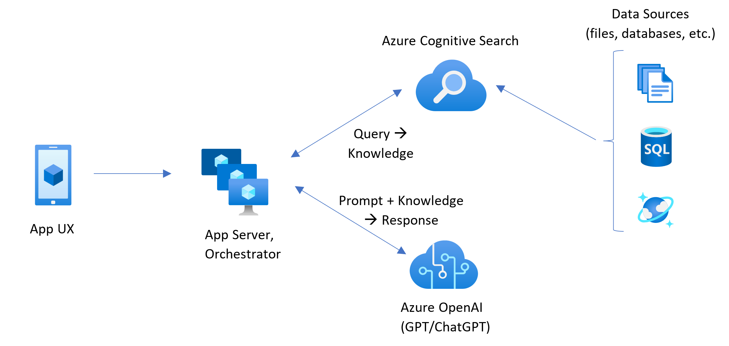
Architecture

Slide 9
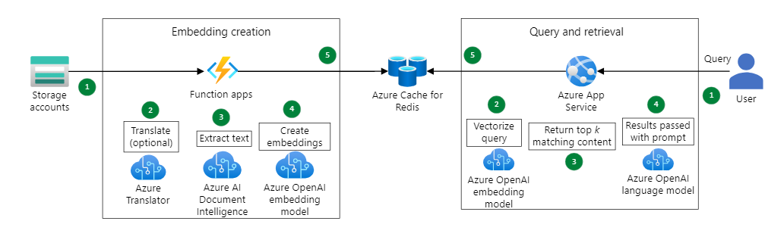
Embedding approach

Slide 10
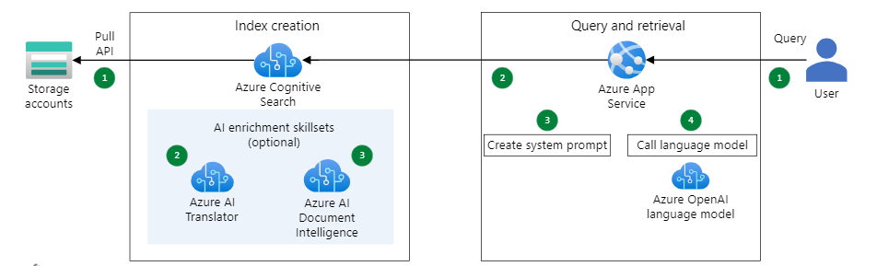
AI Search & Pull approach

Slide 11
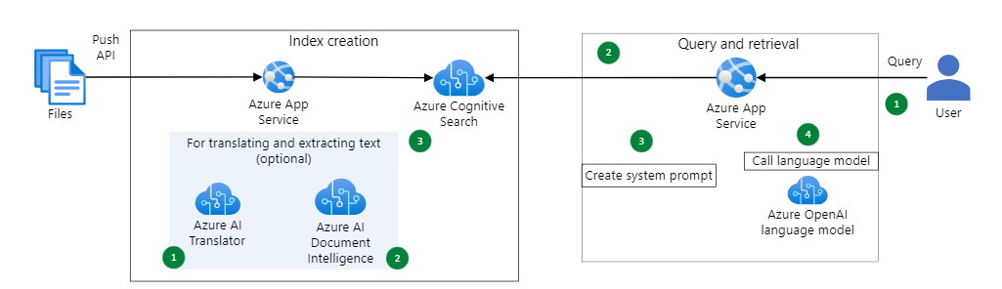
AI Search & Push approach

Slide 12
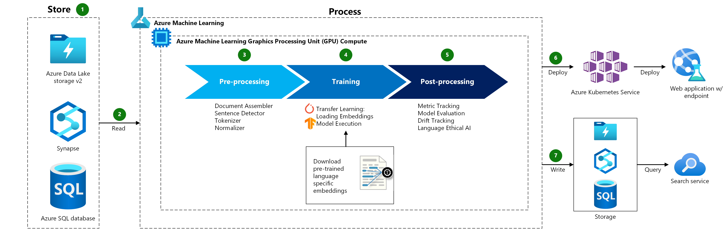
Document Processing

Slide 13
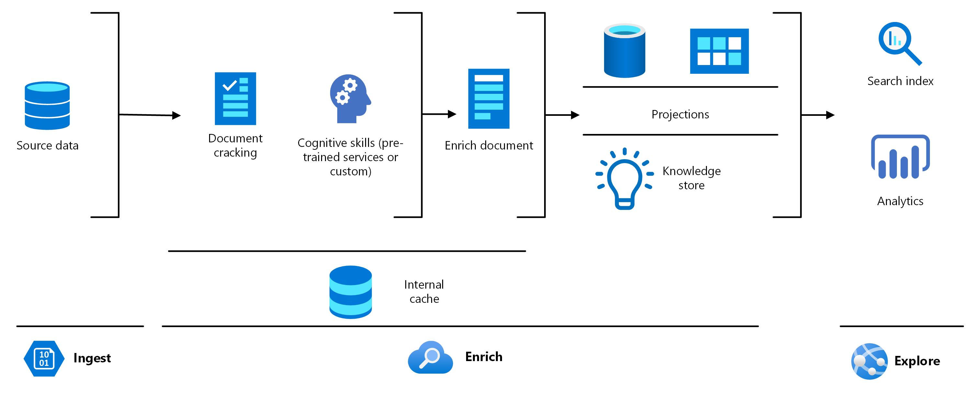
Knowledge Mining

Slide 14
Significance
EFFICIENCY
Improved Relevance
Boarder Coverage
Enhanced Coherence
Contextual Understanding
Flexibility
Domain Adaptation

Slide 15
Demo

Slide 16
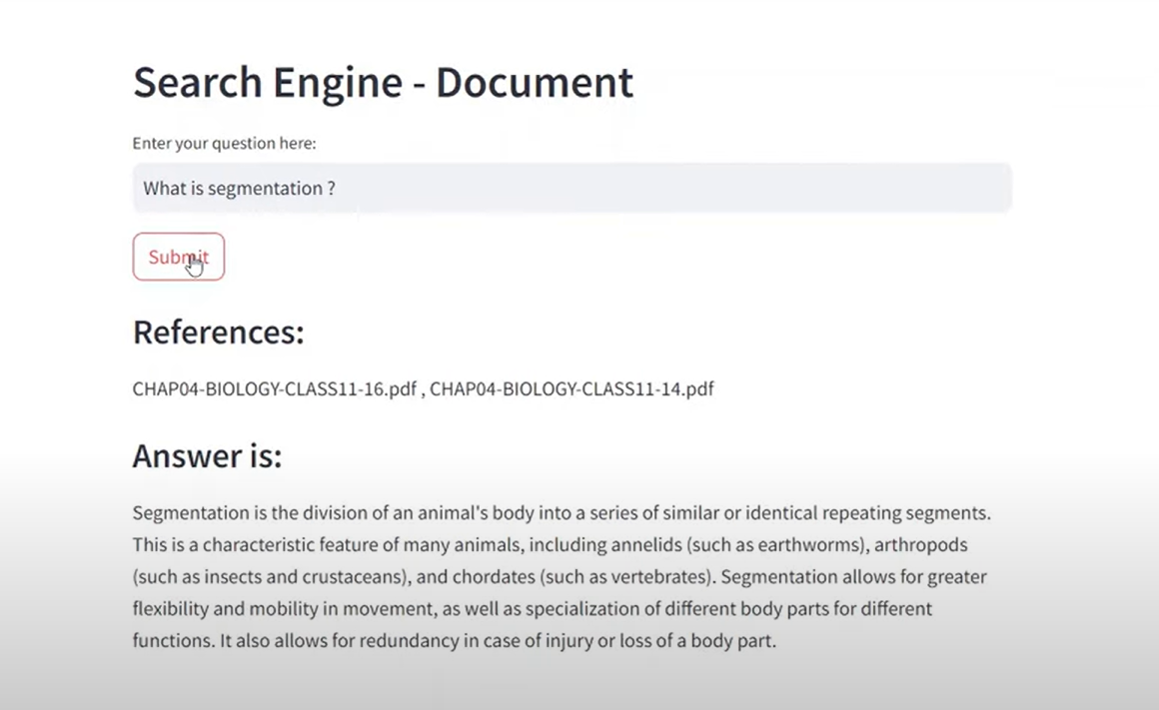

Slide 17
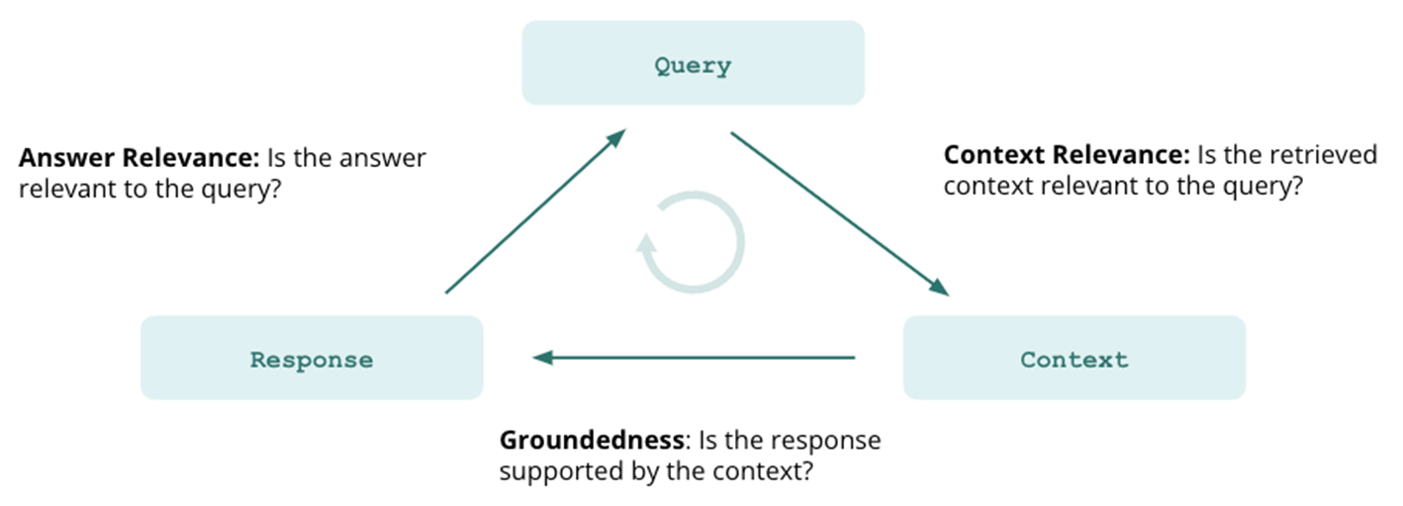
Evaluation Metrics

Slide 18
Q & A

Slide 19
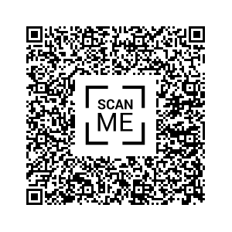
Feedback

